Slide 1

Lecture 11:
Accessing remote resources
CoTaPP: Computational Thinking and
Programming with Python
All icons by: https://www.flaticon.com/

Slide 2

Previous lecture
Reading files (local machine)
Remote resources (server - WWW)
  the basics of resources on the web,
  how to access remote resources (files, REST services),
  XML files
  how to scrape content form the HTML representation of websites
    → web scrapping

Slide 3
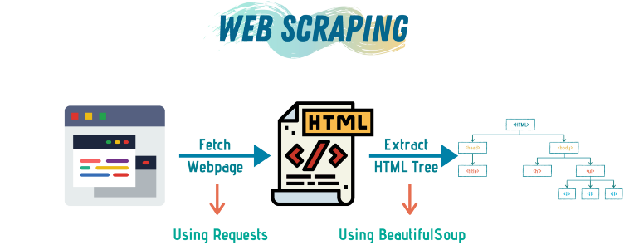
Previous lecture
https://towardsdatascience.com/a-step-by-step-guide-to-web-scraping-in-python-5c4d9cef76e8

Slide 4
Previous lecture
When/why do we need web scrapping?
https://towardsdatascience.com/a-step-by-step-guide-to-web-scraping-in-python-5c4d9cef76e8

Slide 5
Collecting data
Look for data and information to analyze and manipulate

Slide 6
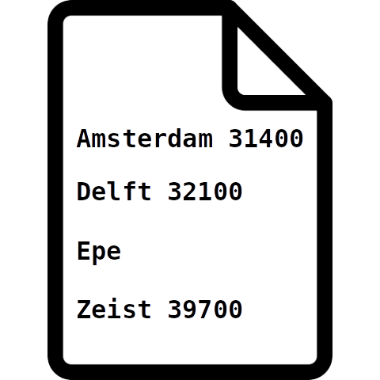
Collecting data
Look for data and information to analyze and manipulate

Slide 7
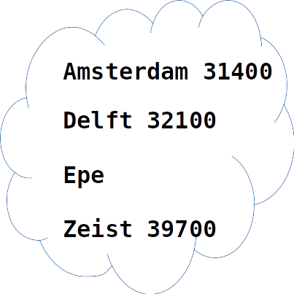
Collecting data
Look for data and information to analyze and manipulate

Slide 8
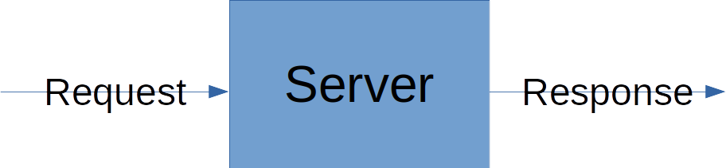
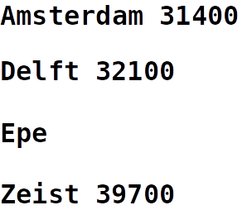
Collecting data
Look for data and information to analyze and manipulate

Slide 9

Collecting data
Look for data and information to analyze and manipulate

Slide 10
Web Scrapping projects
https://www.projectpro.io/article/web-scraping-projects-ideas/475
Flights Ticket Price Analysis

Slide 11
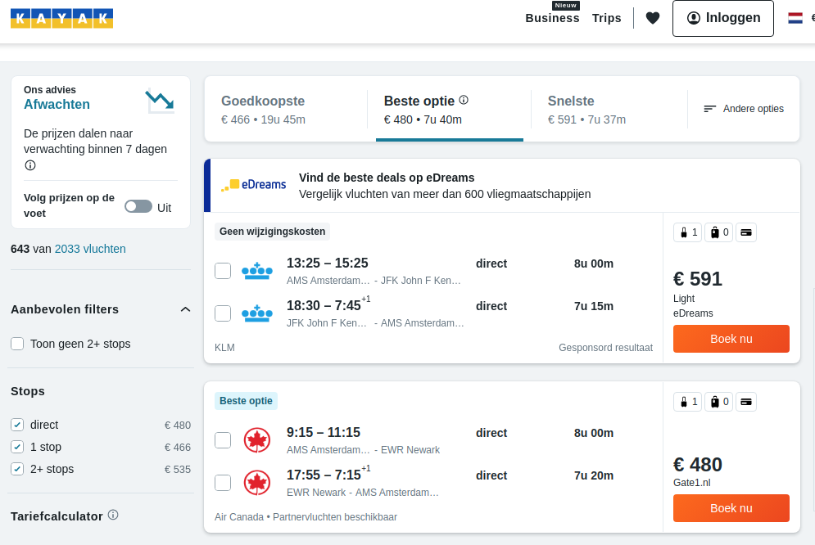
Web Scrapping projects
https://www.projectpro.io/article/web-scraping-projects-ideas/475
Flights Ticket Price Analysis

